Slide 1
Week 9 (11/6): Project Framing

Slide 2
Cultural Analytics
The use of data to study literature, culture, media, and history
Computation plus culture
Not a focus on the what, the content, this or that subject
More a focus on the how, the method, on how computation will change the study of culture and how culture will change the study of computation
Piper, Andrew. “There will be Numbers.” Journal of Cultural Analytics 1, no. 1 (May 23, 2016).

Slide 3
On cultural studies
What counts as evidence?
What is the relationship between theory and practice?
How do we account for the technological mediations of our critique?
Piper, Andrew. “There will be Numbers.” Journal of Cultural Analytics 1, no. 1 (May 23, 2016).

Slide 4
On cultural studies
Computation shows us how the traditional media of cultural studies are flawed portals to understanding culture
The anthropologists notebook
The historian’s archive
The media theoretician’s screen or platform
The art historian’s collection
The literary historian’s book
Piper, Andrew. “There will be Numbers.” Journal of Cultural Analytics 1, no. 1 (May 23, 2016).

Slide 5
On computation
Challenges universalism and neutrality in computing
Reminds us that knowledge is always situated
Allows for greater critical engagement with the ways in which computation structures meaning
Computation in the field of cultural analytics becomes part of the structure of cultural knowledge more generally
Piper, Andrew. “There will be Numbers.” Journal of Cultural Analytics 1, no. 1 (May 23, 2016).

Slide 6
Gaps in the study of culture by computation
Evidence -> a New Generality
Theory -> a New Explicitness
Self-reflexivity -> a New Recursivity
Relevance -> a New Impactfulness
Piper, Andrew. “There will be Numbers.” Journal of Cultural Analytics 1, no. 1 (May 23, 2016).

Slide 7
Gaps in the study of culture by computation
Evidence -> a New Generality
The crisis of metonymy as the fundamental structure of cultural criticism
The power of the local insight
Challenge:
To focus on “the representativeness”
To be self-conscious about being implicated in the knowledge being created
Values the curation of rather than the quantity of data
Piper, Andrew. “There will be Numbers.” Journal of Cultural Analytics 1, no. 1 (May 23, 2016).

Slide 8
Gaps in the study of culture by computation
Theory -> a New Explicitness
Complexity is not inherent to the object but is emergent through the aggregation of lower-level phenomena
We see what does and does not fit into a theory (explanation or prediction)
Lays bare as much as possible of the intellectual practices used to arrive at an argument about culture
Architectonic rather than agonistic
Piper, Andrew. “There will be Numbers.” Journal of Cultural Analytics 1, no. 1 (May 23, 2016).

Slide 9
Gaps in the study of culture by computation
Self-reflexivity -> a New Recursivity
Marks out more clearly the contingencies of knowledge, circumscribes the space of knowledge
Considering methods as models leads us to arguments that reflect the contingencies of representativeness
Part of the process through which culture is generated
Piper, Andrew. “There will be Numbers.” Journal of Cultural Analytics 1, no. 1 (May 23, 2016).

Slide 10
Gaps in the study of culture by computation
Relevance -> a New Impactfulness
Critique is not outside but implicated in the institutional ligatures that make research possible
Promotes agency and advocacy for cultural change
Piper, Andrew. “There will be Numbers.” Journal of Cultural Analytics 1, no. 1 (May 23, 2016).

Slide 11
Cultural Data Analysis
Address head-on the representativeness of evidence
Make explicit theoretical terms as well as the relationship between theory and implementation
Reflect on the extent to which the process of modeling has helped construct knowledge
Attempt to address and intervene in contemporary debates
Piper, Andrew. “There will be Numbers.” Journal of Cultural Analytics 1, no. 1 (May 23, 2016).

Slide 12
Cultural Data Analysis
Has an argument that takes into account and engages critically with research embedded within existing paradigms and debates.
Asks, What precisely does computation allow one to claim that has not been seen before?
Piper, Andrew. “There will be Numbers.” Journal of Cultural Analytics 1, no. 1 (May 23, 2016).

Slide 13
What you need to do CA?
Declare an Interpretive landscape –
what is a good question?
Who cares?
What is a valid conclusion?
What is the best way to relay the argument?
Declare a Method
Something to count or measure (words, phrases, pixels, frequencies)
Something to count or measure with (algorithms)
A scope: a triangulation, a comparison

Slide 14
Interpretive landscapes
Discourse communities: a group of people who share a set of discourses, understood as basic values and assumptions, and ways of communicating about those goals. Linguist John Swales defined discourse communities as "groups that have goals or purposes, and use communication to achieve these goals"
Interpretive communities: Stanley Fish: a text does not have meaning outside of a set of cultural assumptions regarding both what the characters mean and how they should be interpreted.
Standpoint theory (or situated perspective): theory for analyzing inter-subjective discourses; concerns the ways that authority is rooted in individuals' knowledge (their perspectives), and the power that such authority exerts. (Harding, Haraway)

Slide 15
IC: Algorithmic Criticism
This work . . . Proposes that scientific method and metaphor [“scientism”] is, for the most part, incompatible with the terms of humanistic endeavor.
“Algorithmic criticism”—criticism derived from algorithmic manipulation of text . . . Text, transformed algorithmically as a means of gaining entry to the deliberately and self-consciously subjective act of critical interpretation.
Ramsay, Stephen. “Chapter 1: An Algorithmic Criticism.” In *Reading Machines: Toward an Algorithmic Criticism*, 1–17. Topics in the Digital Humanities. Urbana: University of Illinois Press, 2011.

Slide 16
IC: current literary criticism
is skeptical of
authorial intention as a normative principle
linguistic meaning as a stable entity
interpretive objectivity or an unsituated reading
Operates within a hermeneutical framework in which fact, metric, verification, and evidence do not apply
Evaluates conclusions in terms of the nature and depth of the discussions that result
Ramsay, Stephen. “Chapter 1: An Algorithmic Criticism.” In *Reading Machines: Toward an Algorithmic Criticism*, 1–17. Topics in the Digital Humanities. Urbana: University of Illinois Press, 2011.

Slide 17
IC: Algorithmic Criticism: Text Analysis
Represents a heuristic of radical transformation
Not just a new method in the digital space:
Must endeavor to assist the critic in the unfolding of interpretive possibilities
“evidence” that is suggestive of grander arguments and schemes
Ramsay, Stephen. “Chapter 1: An Algorithmic Criticism.” In *Reading Machines: Toward an Algorithmic Criticism*, 1–17. Topics in the Digital Humanities. Urbana: University of Illinois Press, 2011.

Slide 18
Algorithmic Criticism: Text Analysis
My favorite line:
“Just as one might undertake a feminist reading of a text by transporting a set of heuristics from one text to another, so might the algorithmic critic undertake a particular type of reading by transforming a procedure that has been defined in terms of the most modern text, the computer program.”
Ramsay, Stephen. “Chapter 1: An Algorithmic Criticism.” In *Reading Machines: Toward an Algorithmic Criticism*, 1–17. Topics in the Digital Humanities. Urbana: University of Illinois Press, 2011.

Slide 19
Methods: Computational Modeling
Includes:
Features that are computationally tractable, i.e., for complete explicitness and absolute consistency;
Algorithms that manipulate those features that a computational representation provides.
An underst[anding] that the model is an abstract, “temporary state in a process of coming to know rather than fixed structures of knowledge”
--McCarty. “Modeling: A Study in Words and Meanings.” In Companion to Digital Humanities, edited by Ray Siemens, John Unsworth, and Susan Schreibman. Oxford: Blackwell Publishing, December, 2004. Accessed September 14, 2011.

Slide 20
Method: Topic Modeling, e.g.
Topic modeling is a statistical model used in machine learning and “natural language processing”.
Statistical models describe how random variables are related to non random variables. Defined as a relationship between S and P.
S ----- Set of possible observations (also called sample space)
P------ A set of probability distributions on S.
In the humanities, the features are words.
In genomics, the features would be . . . Genes.
In sound studies, the features would be . . . ??

Slide 21
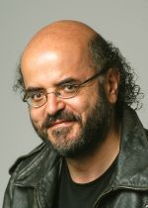
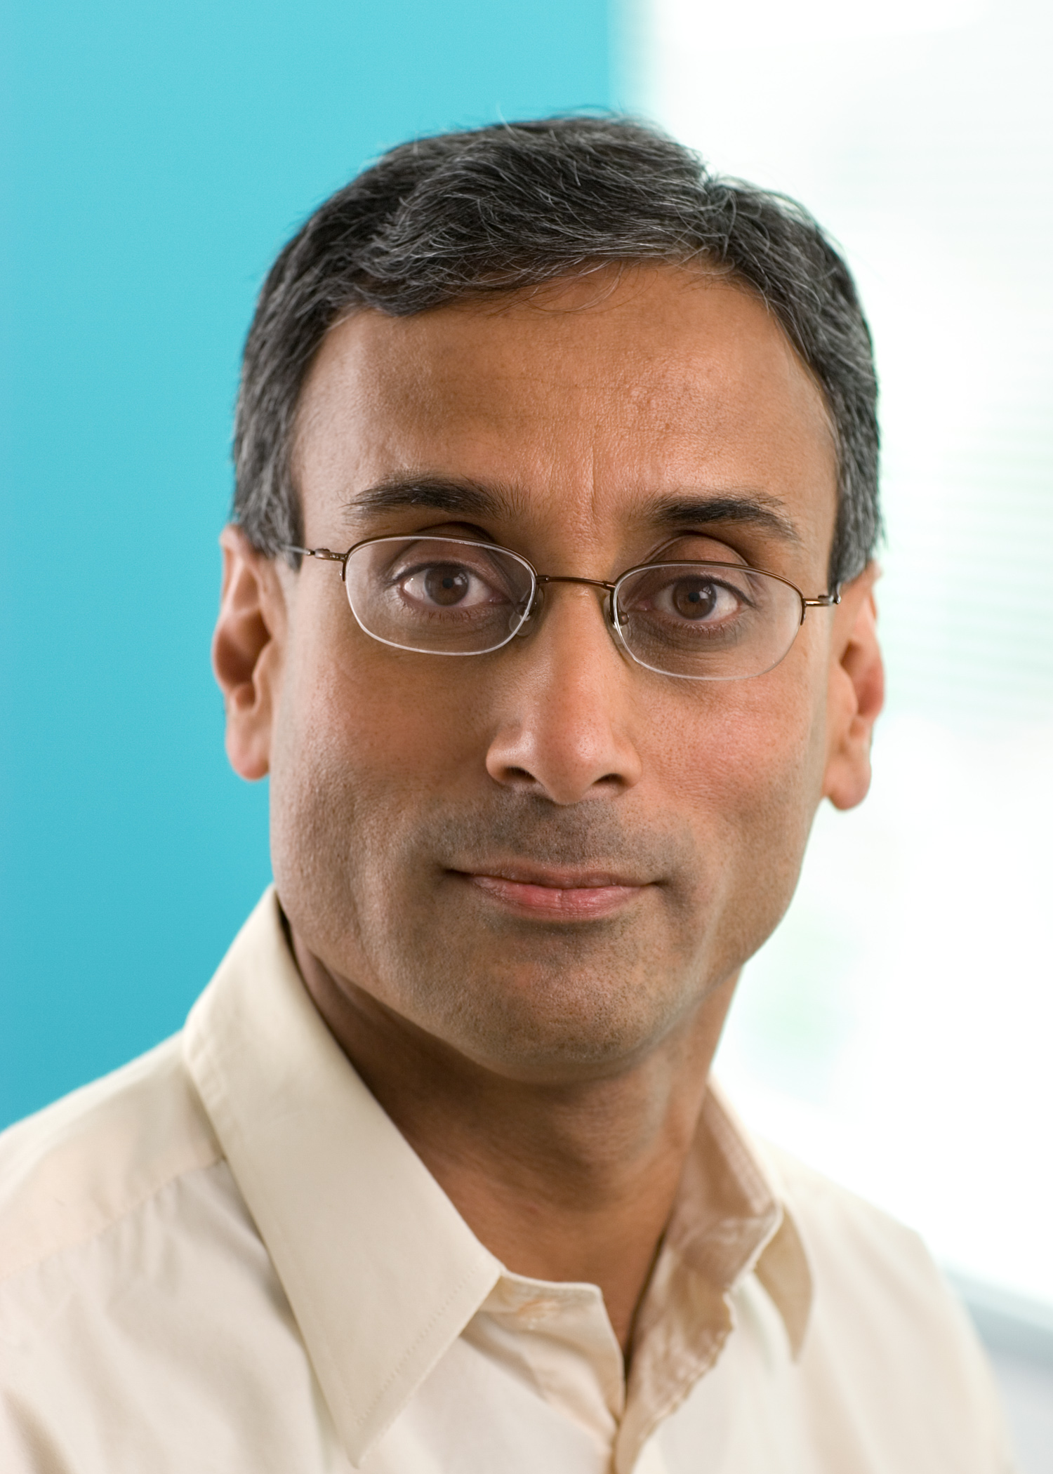

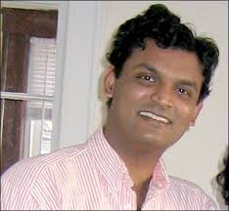
Where did TM come from?
Christos H. Papadimitriou, Prabhakar Raghavan, Hisao Tamaki and Santosh Vempala wrote “Latent Semantic Indexing. A Probabilistic Analysis” in 1997.

Slide 22
Algorithm Developments
PLSA (Probabilistic Latent Semantic Analysis) was created by Thomas Hoffman in 2000. This model presented problems dealing with new documents added to the corpus.
Then, David Blei, Andrew Ng and Michael Jordan created the “Latent Dirichlet Allocation” in 2003, which comes from the PLSA.
Further developments, including the Patchinko allocation, that helps model better correlations between topics and between the words that constitute the topics.

Slide 23
Defining terms for TM
Words (pre-processed):
Tokenized (one word; two-word, etc. Each is unique)
Stop words (little words taken out such as “the,” “and” “a” etc.
Stemming (words chopped to some semblance of roots)
Lemmatization (words taken to their roots)
The structure of the words is usually “a -bag of-words” or all the words without syntax or grammar.
--Burton

Slide 24
Defining terms for TM
Documents
A unit of analysis [e.g., 100 words or a paragraph or a chapter, whatever might yield good results]
Corpus
– a set of documents [e.g., all the paragraphs in a book]

Slide 25
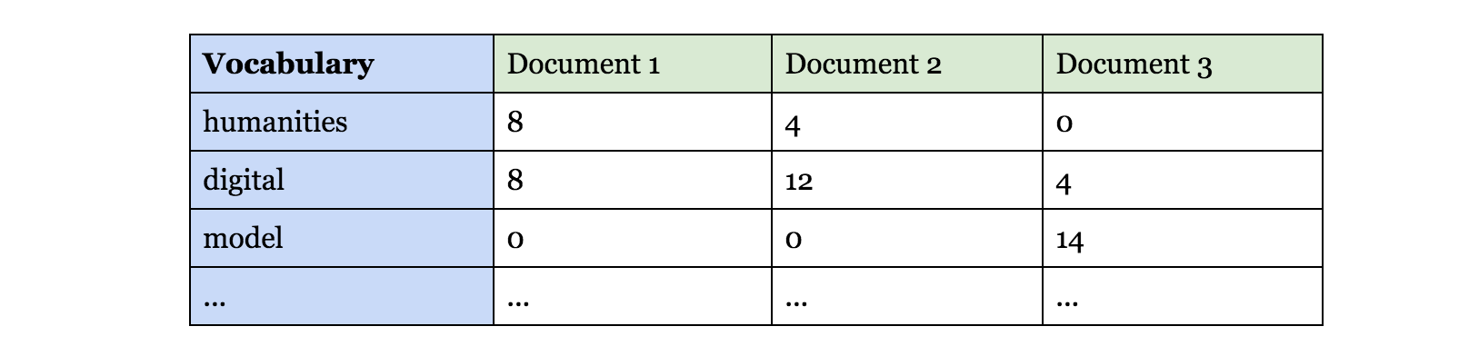
Defining Terms for TM
Term-Document Matrix
Table with one row for every unique token in the corpus
Each column is a document

Slide 26
How is TM done? Generative models
We use generative models to think backwards and try to figure out how specific data is how it is. “What is the likely hidden topical structure [or discourse] that generated my observed documents?”
We use something called “posterior evidence”.
Posterior evidence take the form of latent variables (topics that emerge) that can be observed.
The model that works with MALLET also has a multinomial distribution component.

Slide 27
What is a topic?
“A collection of words that have different probabilities of appearance in passages discussing the topic” -- Ted Underwood
In each topic, different sets of terms have high probability
A topic is a probability distribution over terms
“When I reach into the bag and pull out a word the likelihood I will pull out any particular word depends upon the allotment of words in the bag” -- Burton
Topic models tend to find the sets of terms that tend to occur together in texts
They look like “topics” because terms that frequently occur together tend to be about the same topic
The tendency for topics to concentrate on particular words and documents will eventually be limited by the actual messy distribution of words across documents
Underwood, Ted. “Topic Modeling Made Just Simple Enough.” The Stone and the Shell. April 7, 2012.

Slide 28
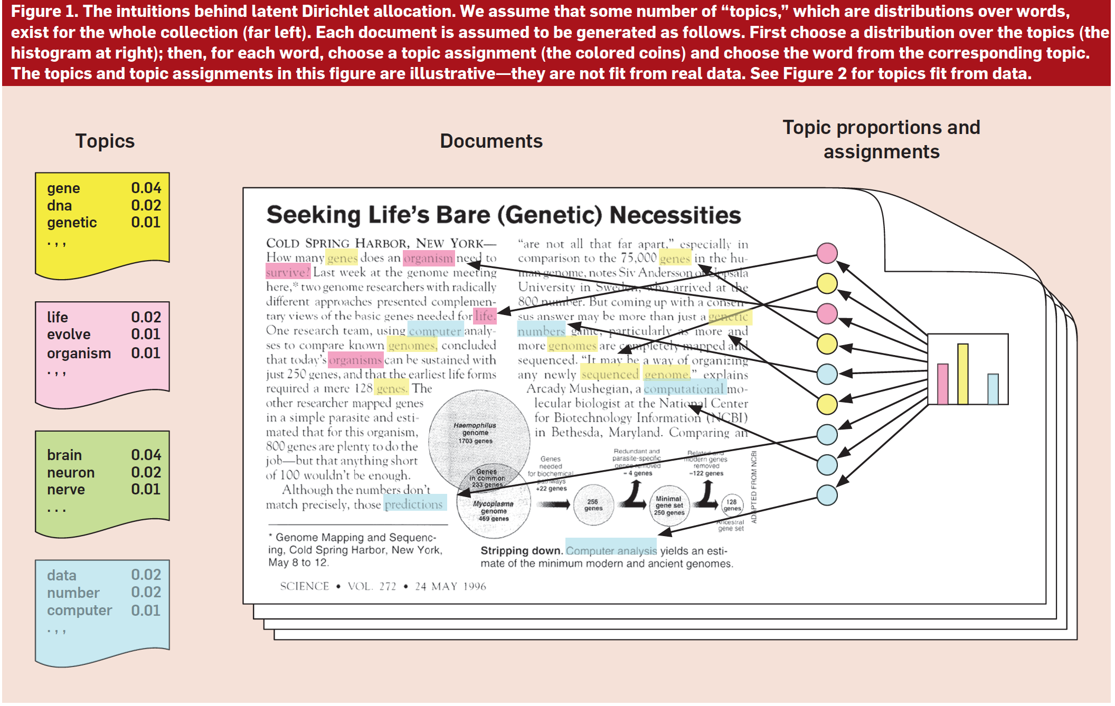
https://www.cs.princeton.edu/~blei/papers/Blei2012.pdf

Slide 29
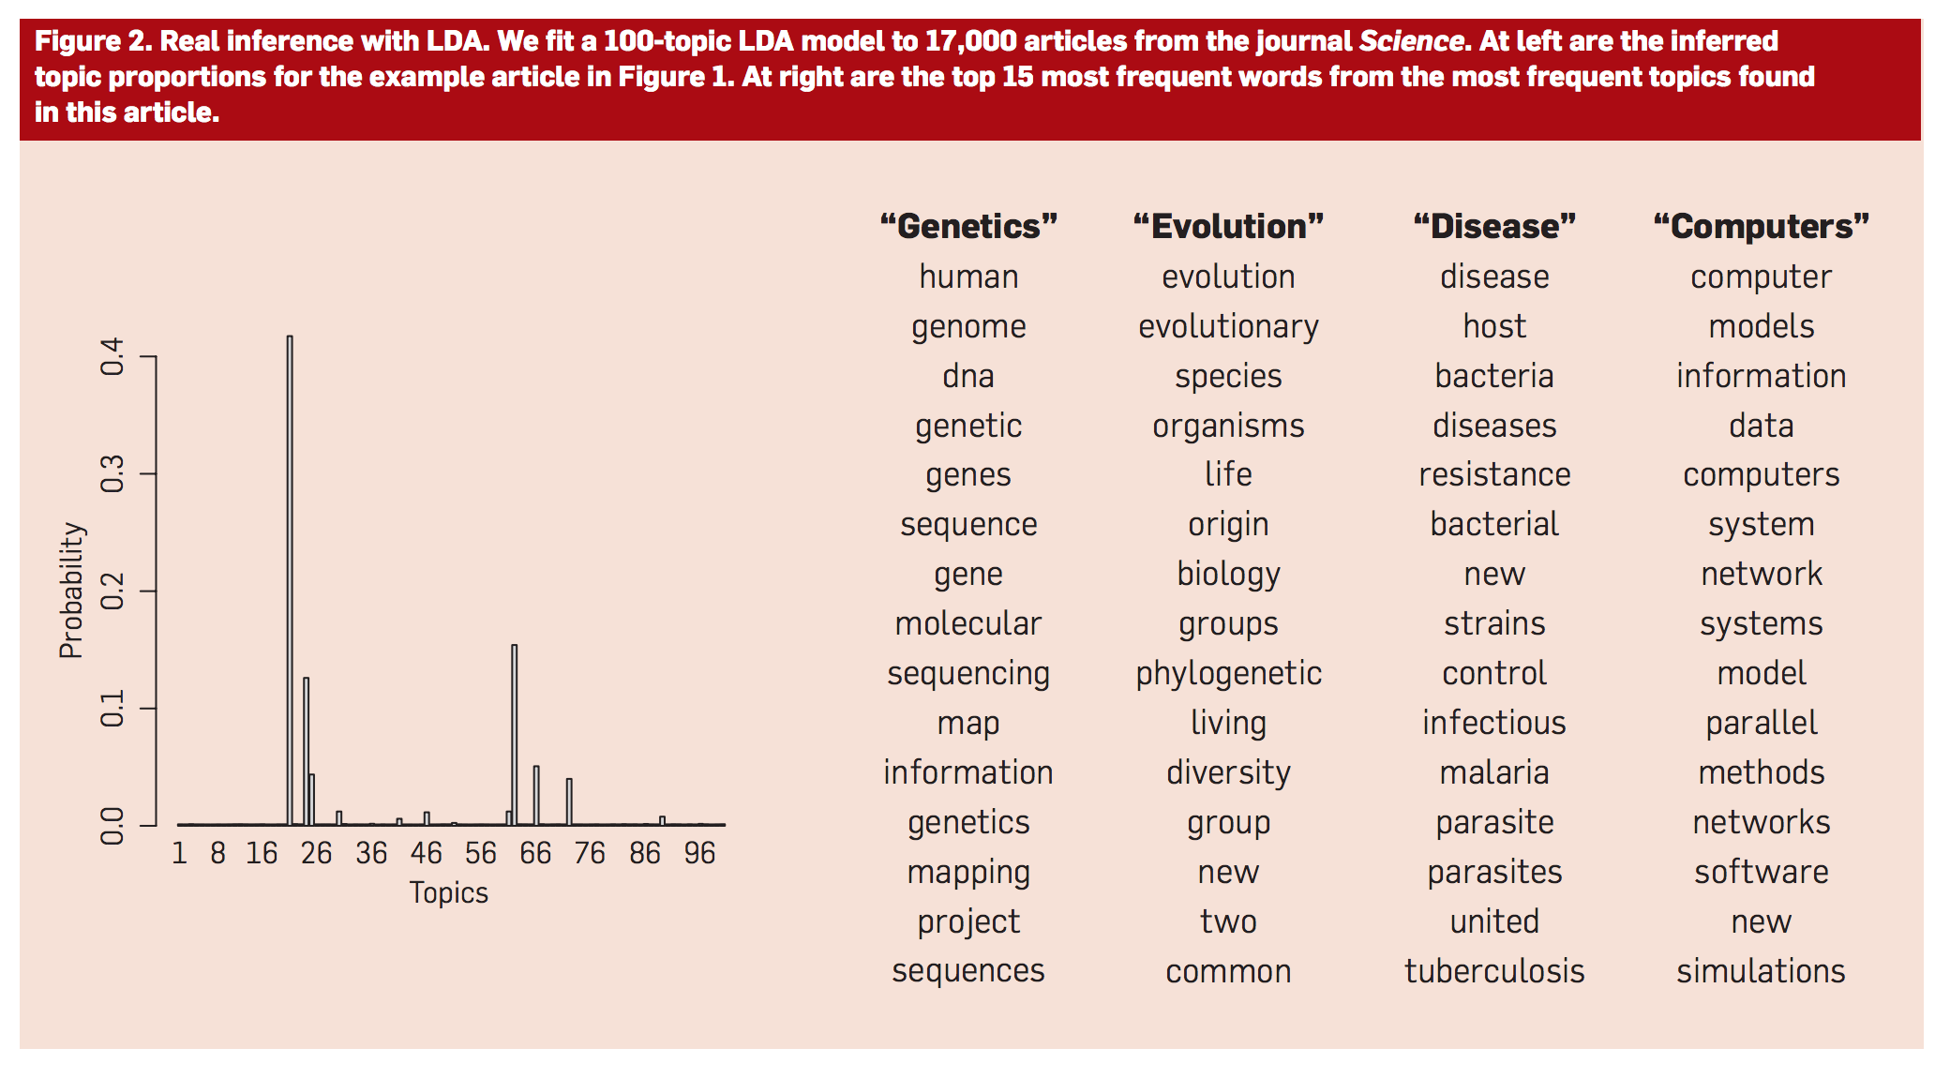
https://www.cs.princeton.edu/~blei/papers/Blei2012.pdf

Slide 30
How is TM done? Generative models
Every document contains a little bit of every topic, although it contains them in different proportions.
You assign words to topics randomly and then just keep improving the model, to make your guess more internally consistent, until the model reaches an equilibrium that is as consistent as the collection allows.
--Underwood

Slide 31
Generative process for LDA
choose the topics, each one from a distribution over distributions.
Then, for each document, choose topic weights to describe which topics that document is about.
Finally, for each word in each document, choose a topic assignment — a pointer to one of the topics — from those topic weights and
then choose an observed word from the corresponding topic.
Each time the model generates a new document it chooses new topic weights, but the topics themselves are chosen once for the whole collection.
Blei, David M. “Topic Modeling and Digital Humanities.” Journal of Digital Humanities. N.p., 8 Apr. 2013. Web. 30 July 2014.

Slide 32
Generative process for a humanist using LDA?
A humanist imagines the kind of hidden structure that she wants to discover and embeds it in a model that generates her archive. The form of the structure is influenced by her theories and knowledge — time and geography, linguistic theory, literary theory, gender, author, politics, culture, history.
With the model and the archive in place, she then runs an algorithm to estimate how the imagined hidden structure is realized in actual texts.
Finally, she uses those estimates in subsequent study, trying to confirm her theories, forming new theories, and using the discovered structure as a lens for exploration.
She discovers that her model falls short in several ways.
She revises and repeats.
--Blei

Slide 33
What does all that mean?
The scholar defines the data. Perhaps, it’s “words” [Stopwords or not? Stemming or not?]
The scholar defines “document” [Are your documents paragraphs? Whole articles? Poems? Whole volumes? ]
The scholar defines “corpus” [Is this all the articles In NYT? All the newspapers in New York for the month of October?]
The scholar defines “topics” [How many topics or piles of words do you think will adequately represent the discourses or topics that are actually in this corpus?]
The scholar decides how refined to make the model [how many iterations do we go through before the piles are the most accurate piles they can be?]

Slide 34
Algorithm: Bayes rule
Basic and one of the most popular statistical rules.
In probability you have to think backwards: predict the series of events that led to a particular outcome. This is a naïve model (assumes there is no interaction between words)
Probability of events A and B
P (A/B) is different than P(B/A)
P (A/B) = P (A and B) = P (A) P (B/A)
__________ _____________
P (B) P (B)

Slide 35
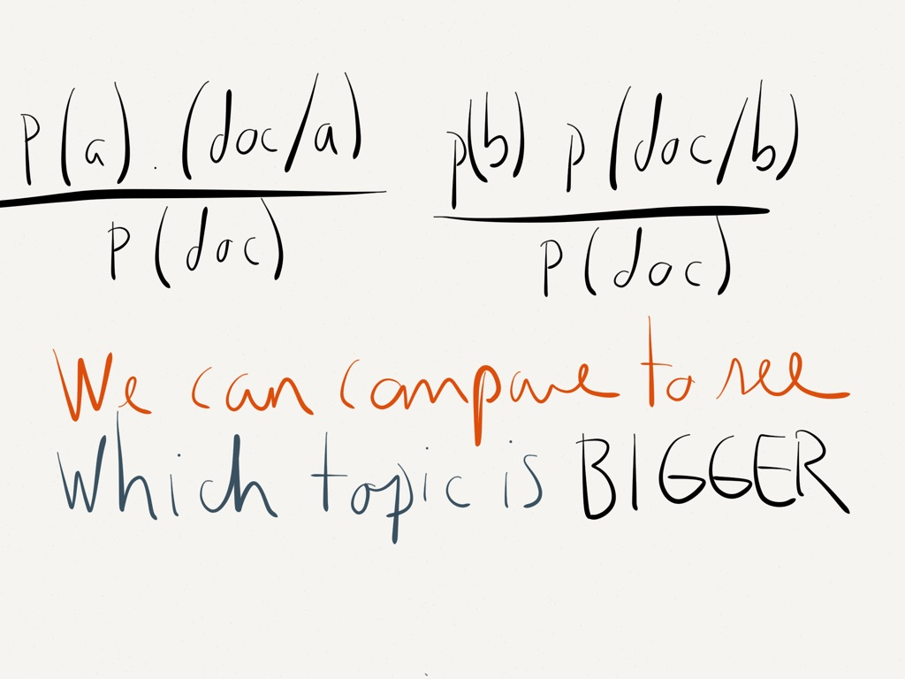
Algorithm: Bayes rule and TM
We assume we have one topic per document. LDA works different.

Slide 36
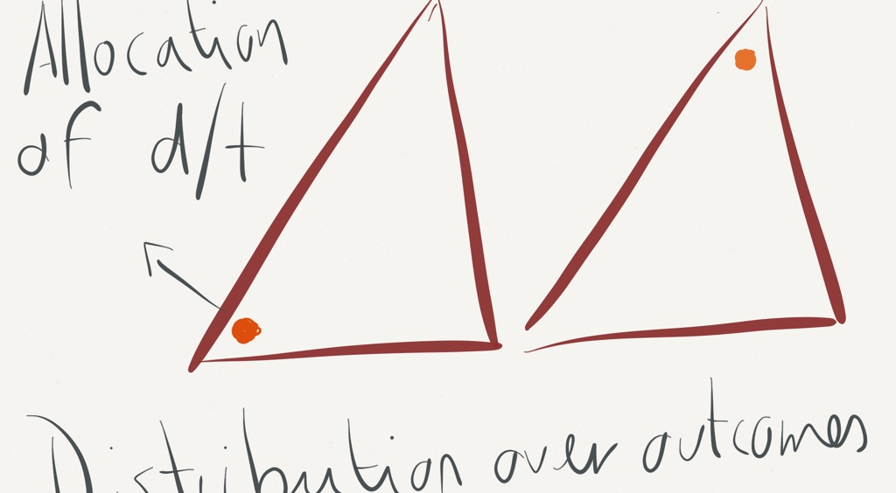
Dirichlet distribution

Slide 37
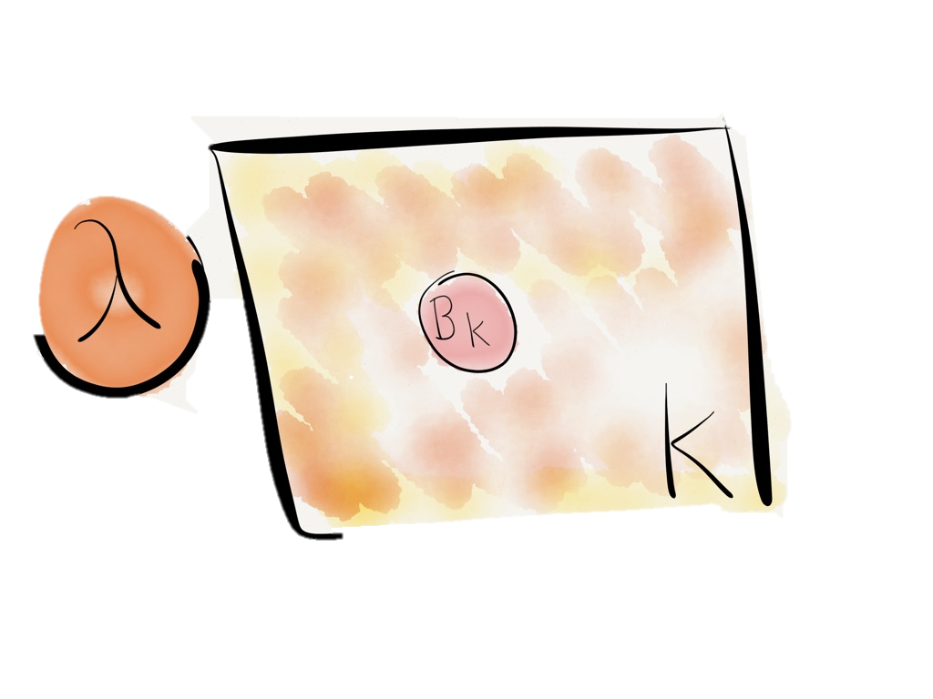
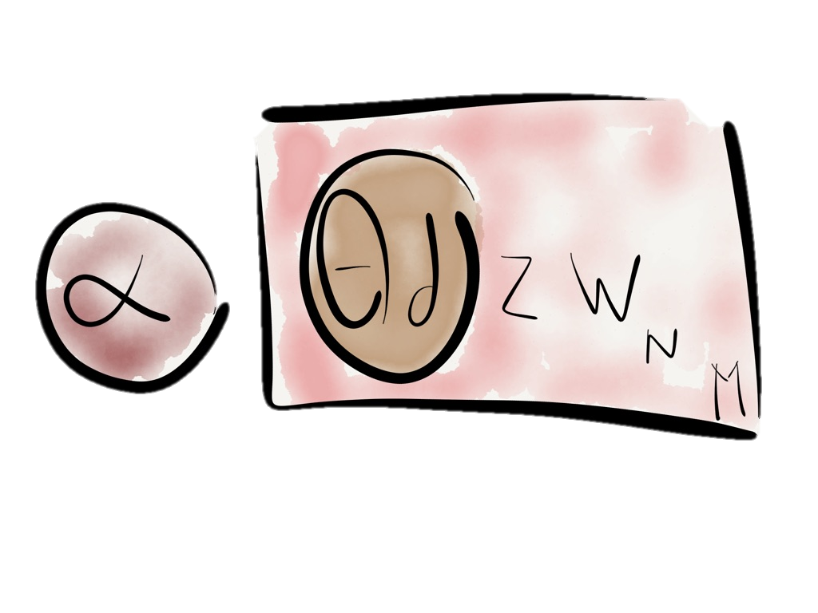
Each topic is a distribution over words. Comes from a Dirichlet distribution with parameter Lambda.
Each document is a distribution over topics. Comes from a Dirichlet distribution with parameter Alpha.

Slide 38
The model
Each word is associated with one and only one of the topics: this is how the topics get assigned to words.
Since we have initial random topics, what we do with Gibbs Sampling is reassign topic assignments of individual words. This latent variable is called Z_{dn}
Imagine we have a document that has topics. We reassign the words within that document to the topics we chose. And we do that in an iterative way.

Slide 39
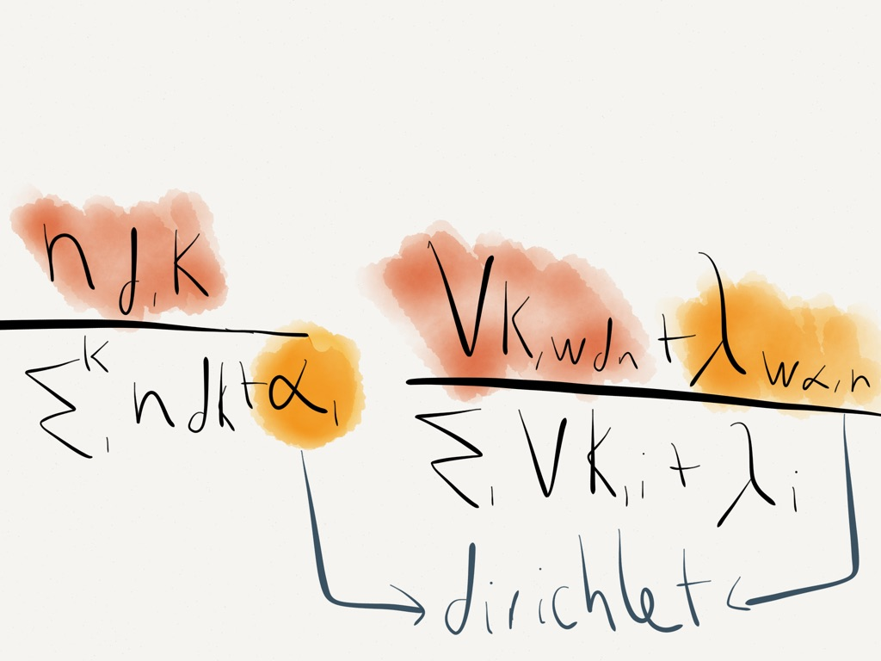
Gibs sampling (take a look)

Slide 40
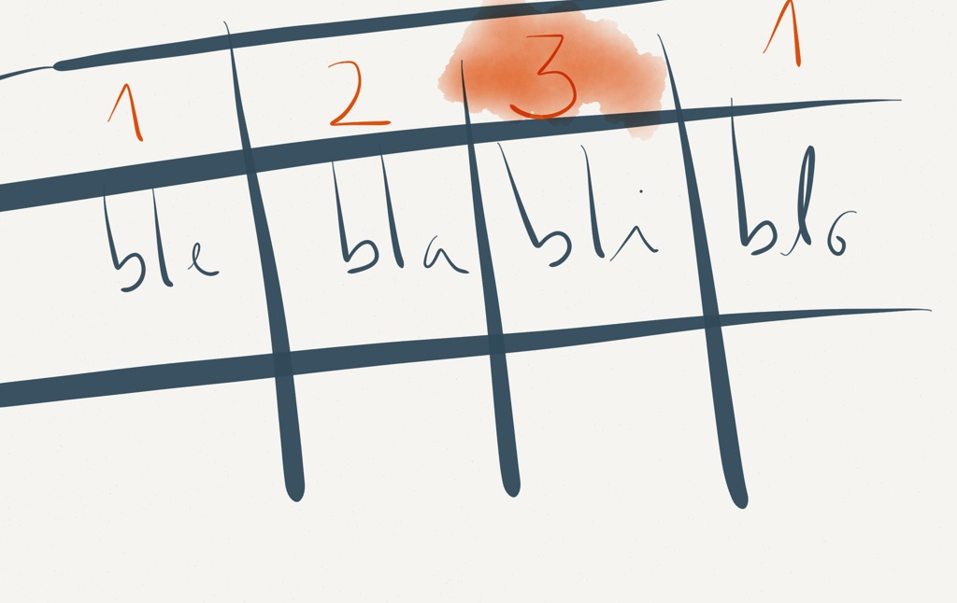
Assign, reassign, weight topics

Slide 41
What next?
Some of the important questions in topic modeling have to do with how we use the output of the algorithm.
--Blei

Slide 42
Why TM?
Take the example of a newspaper collection you’ve just digitized: scanned and OCRd (with 100% perfect results!).
You have NO metadata
It appears you have found a topic that you have labeled “sports” because it includes words like “tennis”, “match”, “team,” “field,” etc.
Now you can follow the progress of that topic over time? Is there a time when sports were written about more? Is there a part of the paper where sports used to appear? Has it changed?

Slide 43
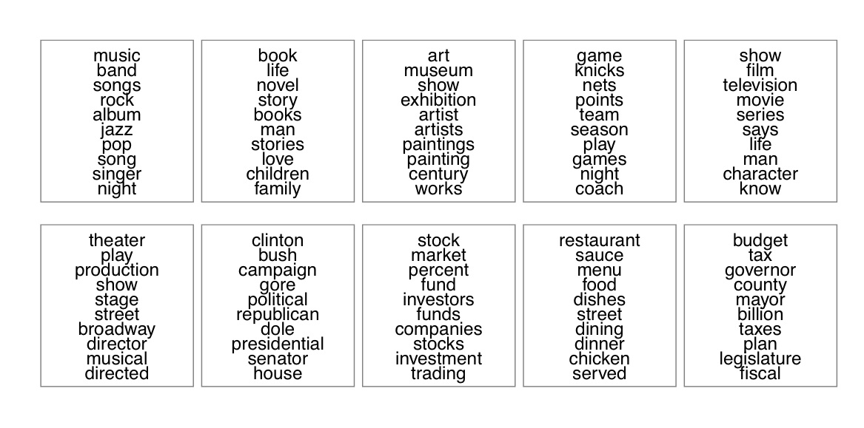
Figure 1: Some of the topics found by analyzing 1.8 million articles
from the New York Times. Each panel illustrates a set of tightly
co-occurring terms in the collection. Hoffman, M., Blei, D. Wang, C.
and Paisley, J. “Stochastic variational inference.”
Journal of Machine Learning Research

Slide 44
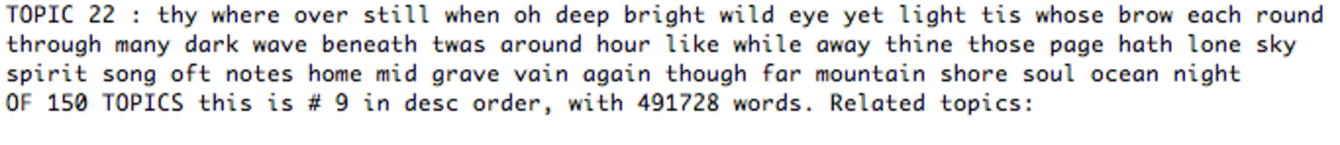
Why TM?
Take the example of a collection of literary texts. Your topic looks like this:
What is it?
--Ted Underwood

Slide 45
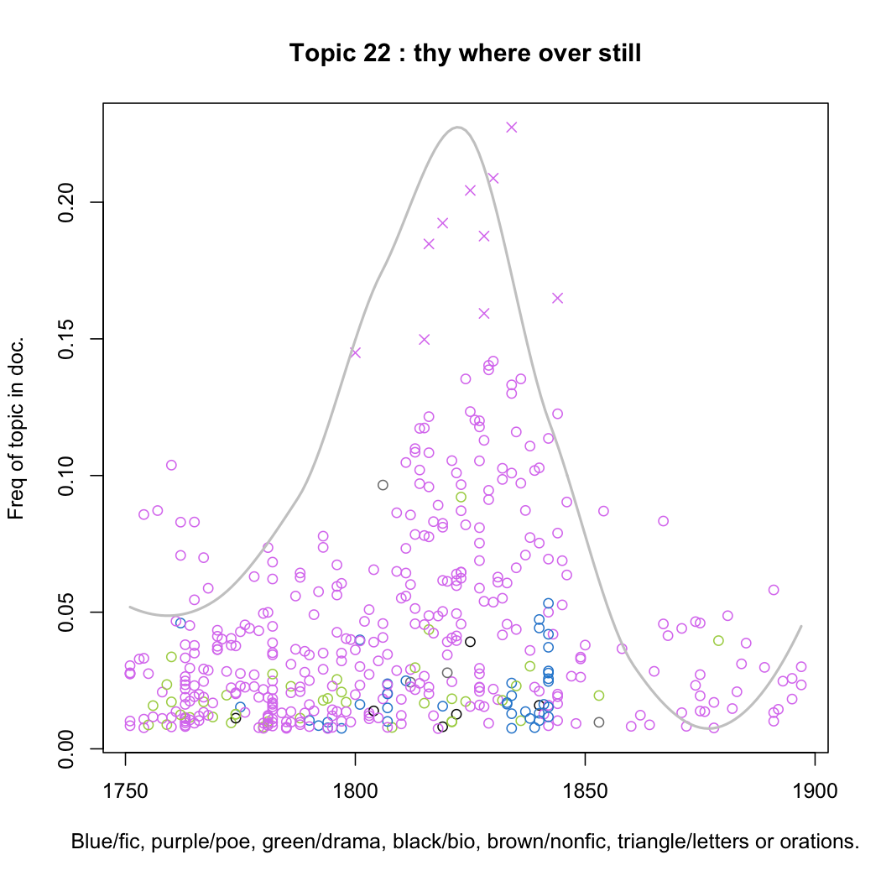
Poetry!
Or rather, poetic discourse

Slide 46
The argument
With probabilistic modeling for the humanities, the scholar can build a statistical lens that encodes her specific knowledge, theories, and assumptions about texts. She can then use that lens to examine and explore large archives of real sources.
--Blei

Slide 47
Note that the statistical models are meant to help interpret and understand texts;
it is still the scholar’s job to do the actual interpreting and understanding.
A model of texts, built with a particular theory in mind, cannot provide evidence for the theory.[5] (After all, the theory is built into the assumptions of the model.)
Rather, the hope is that the model helps point us to such evidence. Using humanist texts to do humanist scholarship is the job of a humanist.
--Blei

Slide 48
Final Presentation
*The presentation should be professional and limited to 10 minutes with 2 minutes for questions/answers for a total of 12 minutes per student.
*Your final presentation should be on some sort of presentation software that you can share and will include:
1. A description of your dataset from a cultural heritage institution (think gallery, library, archive or museum -- Where did it come from? What does it include? What structure was it in when you discovered it and what have you had to do to restructure it for this project? You may have chosen to extend or limit the dataset in some way. This might mean curating material from multiple sources, mashing up two or more datasets, etc.

Slide 49
Final Presentation
2. A description of your interpretive/discourse community in mind, such as literary scholars interested in feminist inquiry, historians interested in postcolonialism, or information studies researchers interested in critical metadata.
3. A description of your method. What "features" of the data are you using to learn more about your argument? Why? What kinds of algorithms? Why? This will be a reflection on the strengths and weaknesses of your method, including a walk-through of a Jupyter notebook containing code used for data analysis and visualization.
4. Your working argument about the data based on what the interpretive/discourse community values.
5. 3-4 visualizations of initial observations.
6. Citations.

Slide 50
A description of your dataset from a cultural heritage institution (think gallery, library, archive or museum -- Where did it come from? What does it include? What structure was it in when you discovered it and what have you had to do to restructure it for this project? You may have chosen to extend or limit the dataset in some way. This might mean curating material from multiple sources, mashing up two or more datasets, etc.
A description of your interpretive/discourse community in mind, such as literary scholars interested in feminist inquiry, historians interested in postcolonialism, or information studies researchers interested in critical metadata.
A description of your rproposed method. What "features" of the data are you using to learn more about your argument? Why? What kinds of algorithms? Why? This will be a reflection on the strengths and weaknesses of your method, including a walk-through of a Jupyter notebook containing code used for data analysis and visualization.
Your working argument about the data based on what the interpretive/discourse community values.

